Slide 1
Types of Optimization Models

Slide 2
Model Formulations
Different types of optimization model formulations exist:
  Classical non-linear formulation
  Linear Programming formulation
  Baseline model formulation
  Goal Programming formulation
  Compromise Decision Support Problem formulation
  etc.
Basic classifications are:
  Constrained versus unconstrained
  Linear versus non-linear
  Single objective versus multi-objective
Another classification can be made by variables:
  continuous/discrete/mixed-integer

Slide 3
Introduction to Multi-Objective Optimization

Slide 4
Single versus Multi-Objective
What should you use and what is available?
Most important rule:
Never restrict yourself in modeling!
Design is multi-objective by nature, so we will look at some multi-objective formulations first.

Slide 5
Different formulations
There are different ways to formulate a multi-objective optimization model
Some covered are:
  Baseline model
  Goal Programming (GP) model
  Compromise Decision Support Problem model
Others exist

Slide 6
Baseline Model
Ignizio proposes the following “baseline” model:
Find
The vector of problem variables
X
Satisfy
The goals
≥
A
t
(
X
)
= T
t
for all t
≤
Maximize:
A
r
(
X
)
for all r
Minimize:
A
s
(
X
)
for all s
He argues that this is one of the most generic and flexible mathematical programming models.
What is missing?

Slide 7
Goal Programming (GP)
Another multiobjective mathematical “programming” technique is Goal Programming (GP)
The term "goal programming" is used by its developers to indicate the search for an "optimal" program (i.e., a set of policies to be implemented) for a mathematical model that is composed solely of goals.
Developers argue that any mathematical programming model may find an equivalent representation in GP.
“GP provides an alternative representation that often is more effective in capturing the nature of real world problems.”

Slide 8
Difference between Objectives and Goals
In Goal Programming a distinction is made between an objective and a goal:
Objective: In mathematical programming, an objective is a function that we seek to optimize, via changes in the problem variables.
The most common forms of objectives are those in which we seek to maximize or minimize. For example,
Minimize Z = A(X)
Goal: In short, a goal is an objective with a “right hand side”.
This right hand side (T) is the target value or aspiration level associated with the goal. For example,
A(X) ≥ T

Slide 9
Solving Multi-objective Models
Solving multi-objective models is NOT standard practice (yet).
Often, a first step in solving these models is a model transformation into a model that CAN be solved using an existing algorithm/solver.
How do we solve such a baseline model?
For example, for solving a baseline model, we can convert it to:
  single objective nonlinear programming (NLP) problem.
  multi-objective Goal Programming (GP) problem.
  multi-objective compromise Decision Support Problem (DSP).
  other...

Slide 10
Some Model Transformation Basics

Slide 11
Transforming a baseline model into a GP model
Here are steps how to transform a “baseline model” into a “GP” model:
Step 1
: Transform
all objectives into goals by establishing associated aspiration
levels based on the belief that a real world
decision maker can usually cite (initial)
estimates of his or her aspiration levels. Hence,
maximize A_{r}(X) becomes A_{r}(X) ≥ T_{r} for all r
minimize A_{s}(X) becomes A_{s}(X) ≤ T_{s} for all s.
where T
and T
are the respective aspiration levels (targets).
r
s
Step 2
Rank-order each goal according to its perceived importance. Hence, the set
:
of hard goals (i.e., constraints in
traditional math programming) is always assigned
the top priority or rank.
Step 3
: All the goals must be converted into equations through
the addition of
deviation variables

Slide 12
Going from Inequalities to Equalities

Slide 13
Converting Inequalities - Standard Approach
Note: A computer does not “like” inequalities.
Thus: Inequalities have to be converted to equalities
In general, converting equalities to inequalities is achieved by adding variables.
This is a VERY common practice in optimization.

Slide 14
Deviation Variables - “Distance to target”
In Goal Programming and other approaches (like compromise Decision Support Problem) “deviation” variables are used to convert inequalities to equalities.
The deviation variable d is (then) defined as:
d = T
i
- A
i
(
X
)
Note: Mathematically, the deviation variable d can be negative, positive, or zero.
From a reality point of view, a deviation variable represents the distance (deviation) between the aspiration level (target) and the actual attainment of the goal.

Slide 15
Two Deviation Variables instead of One
The deviation variable d can be replaced by two variables:
d = d_{i}⁻ - d_{i}⁺
where d_{i}⁻ • d_{i}⁺ = 0 and d_{i}⁻, d_{i}⁺ ≥ 0
Why? Many optimization algorithms do not “like” negative numbers and the preceding ensures that the deviation variables never take on negative values.
The product constraint ensures that one of the deviation variables will always be zero.
The goal formulation (now) becomes:
A_{i}(X) + d_{i}⁻ - d_{i}⁺ = T_{i}; i = 1,2, . . . , m
subject to d_{i}⁻ • d_{i}⁺ = 0 and d_{i}⁻, d_{i}⁺ ≥ 0

Slide 16
Values of Deviation Variables
Note that a goal is always expressed as an equality:
A_{i}(X) + d_{i}⁻ - d_{i}⁺ = T_{i}; i = 1,2, . . . , m
And when considering this equality, the following will be true:
if A_{i}(X) < T_{i} is true, then (d_{i}⁻ > 0 AND d_{i}⁺ = 0) must be true;
if A_{i}(X) > T_{i} is true, then (d_{i}⁻ = 0 AND d_{i}⁺ > 0) must be true;
if A_{i}(X) = T_{i} is true, then (d_{i}⁻ = 0 AND d_{i}⁺ = 0) must be true.
When in doubt, just use a numerical example.

Slide 17
“Desired” Values of Deviation Variables
Again, note that a goal is always expressed as an equality.
A_{i}(X) + d_{i}⁻ - d_{i}⁺ = T_{i}; i = 1,2, . . . , m
To achieve a goal (i.e., reach the target), 3 situations are possible:
1. To satisfy A_{i}(X) ≤ T_{i}, we must ensure that the deviation variable d_{i}⁺ is zero.
  - The deviation variable d_{i}⁻ is a measure of how far the performance of the actual design is from the goal.
2. To satisfy A_{i}(X) ≥ T_{i}, the deviation variable d_{i}⁻ must be made equal to zero.
  - In this case, the degree of “overachievement” is indicated by the positive deviation variable d_{i}⁺.
3. To satisfy A_{i}(X) = T_{i}, both deviation variables, d_{i}⁻ and d_{i}⁺ must be zero.
Question: How would this change if we only had a single d_{i} that can be positive or negative?
Thus, to achieve a target, we must minimize the unwanted deviation(s)!

Slide 18
Minimizing deviations
Consider the preceding three situations again.
To achieve a goal (i.e., reach the target), 3 situations are possible:
1. To achieve A_{i}(X) ≤ T_{i}, we must minimize ( d_{i}⁺ )
2. To achieve A_{i}(X) ≥ T_{i}, we must minimize ( d_{i}⁻ )
3. To achieve A_{i}(X) = T_{i}, we must minimize (d_{i}⁻ + d_{i}⁺ ).
(How would this change if we only had a single d_{i} that can be positive or negative?_
Big Question: What if you have more than one goal?
That is, how do you minimize multiple deviation variables?

Slide 19
Prioritizing Goals

Slide 20
Two Approaches to Prioritizing Goals
Goals are not equally important to a decision maker.
How do we represent our preferences?
Two approaches are:
1) Assign weights and calculate the sum of the deviation variables (‘distance to target’) multiplied by their individual weights.
Rank order goal deviations in priority levels, often referred to as a preemptive formulation. The preemptive formulation does not exclude the assignment of weights.
Note: Other techniques exist, but right now we focus on the above two.

Slide 21
Weighted Sum Approach
Assigning weights, or weighted sum approach, is one of the most common ways of converting multi-objective/multi-goal problems into a single objective problem.
Min z = (w₁d₁⁻ + w₂d₂⁺ + ….) = Σ (w_{i}d_{i}⁻ + w_{k}d_{k}⁺ )
The weights (w) can be any value, in principle.
  In case the sum of the weights equals 1, then we speak of an archimedean formulation.
However, assigning weights without thought can cause problems.
  Can you name some?

Slide 22
Rank Ordering
In Rank Ordering, you prioritize one goal/objective above each other without giving explicit mathematical weights.
  Basically, in words, Goal A has to be achieved before Goal B. I should not even think about Goal B yet if Goal A has not been achieved yet.
One mathematical construct that is used in rank ordered formulations is the Lexicographic Minimum.
The concept of a lexicographic minimum is used in several multi-objective formulations
  Goal Programming
  Compromise DSP

Slide 23
Lexicographic Minimum - Definition
LEXICOGRAPHIC MINIMUM Given an ordered array f^{(i)} = (f₁, f₂, ... , f_{n}) of nonnegative elements f_{k}’s, the solution given by f⁽¹⁾ is preferred to f⁽²⁾ iff
f_{k}⁽¹⁾ < f_{k}⁽²⁾
and all higher order elements (f₁, …, f_{k-1}) are equal. If no other solution is preferred to f⁽¹⁾, then f⁽¹⁾ is the lexicographic minimum.
Examples?

Slide 24
Compromise Decision Support Problem formulation
Given:
  Relevant information
Find:
  System variables
  Deviation variables
Satisfy:
  System constraints
  System goals
Minimize:
  Deviation function
Arguably, just “another” multi-objective optimization model, but it is geared towards engineering design.
Note use of different “keywords” (given, find, satisfy, minimize).

Slide 25
The Effect of Selecting a Formulation
It is important to note that differences in formulation CAN cause differences in results.
The most influential factors are the choices of:
  Objectives versus goals
  Goal Priorities
  Constraints versus goals (constraints are higher priority)
  Goal targets

Slide 26
Case Study/Example

Slide 27
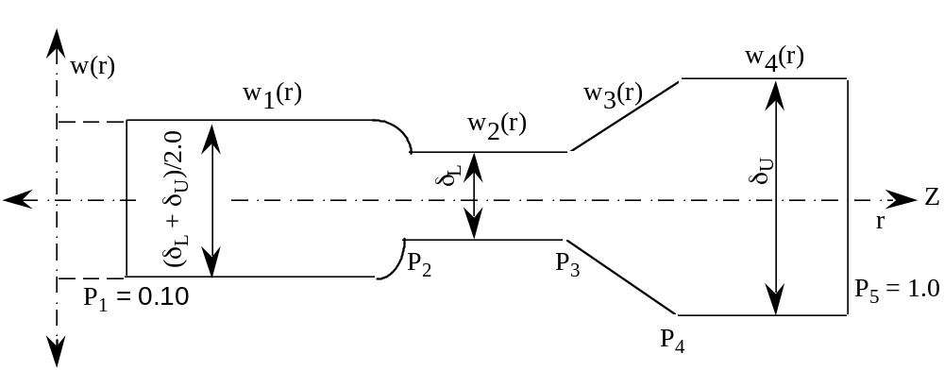
Rotating Disk (Flywheel) Example
Experimental evidence suggests that at high speeds the stresses are high near the hub of the rotating disk. For this reason, to get the stresses within safe limits, it is advisable to have more mass near the hub.
The design criterion is to locate the points, P2 to P4 such that the kinetic energy is maximized and the mass of the rotating disk is minimized.

Slide 28
“Baseline” Model for Flywheel
Given
The relevant information for the disk:
Angular velocity of the disk
ω
= user input (rad/sec)
Lower limit of thickness
δ
L
= 0.01 (m)
Upper limit of thickness
δ
U
= 0.10 (m)
Location of the hub
P
1
= 0.05 (m)
Location of the rime
P
5
= 0.5 (m)
Slope of the linear portion
δ
’
= 0.9
3
Density of the material of disk
ρ
=7830 (kg/m
)
Yield stress of the material of disk
YS
=1.48E9 (N/m
2
)
Relevant equations for the physics of the problem.
Find
System variables
What is wrong with this “Baseline” model?
They determine the profile of the rotating disk,
P
2,
P
3
, and P
4.
Satisfy
System constraints
The stress constraints,
σ
(r)
Š
σ
R
≤
y,
σ
T
(r) ≤
σ
y,
where
σ
R
,
σ
T
,
and
σ
y
are the radial stress, tangential stress and yield stress
respectively.
The constraints on the geometry of the rotating disk,
P
1
≤
P
2
,
P
2
≤
P
3
,
P
3
≤
P
4
,
P
4
≤
P
5
.
Maximize
The kinetic energy (K) of the rotating disk is to be maximized.
Minimize
The weight (M) of the rotating disk is to be minimized.

Slide 29
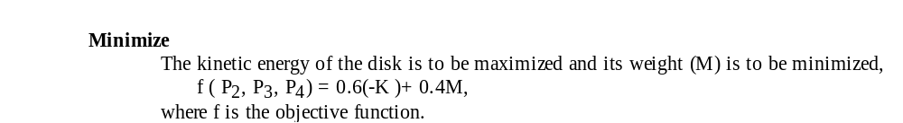
Different single objective functions
Minimize
The kinetic energy (K) of the rotating disk is to be maximized,
f(P₂, P₃, P₄) = -K
where f is the objective function.
Minimize
The weight (M) of the rotating disk is to be minimized,
f(P₂, P₃, P₄) = M
where f is the objective function.
Weighted sum approach:

Slide 30
Different Design Scenarios
The compromise DSP template is exercised in three ways,
The deviation function is modeled in the preemptive form with the achievement of the kinetic energy goal as first priority.
the deviation function is modeled in the preemptive form with the achievement of the weight goal as first priority.
the deviation function is formulated for the Archimedean form giving a weight of 0.6 for the achievement of the aspiration level of the kinetic energy of the disk and a weight of 0.4 for the weight of the disk.
The traditional single-objective model is exercised in three ways,
one with kinetic energy as objective function and mass of the disk as constraint,
the other with mass of the disk as objective function and kinetic energy as constraint, and
as a weighted sum of the two objectives.

Slide 31
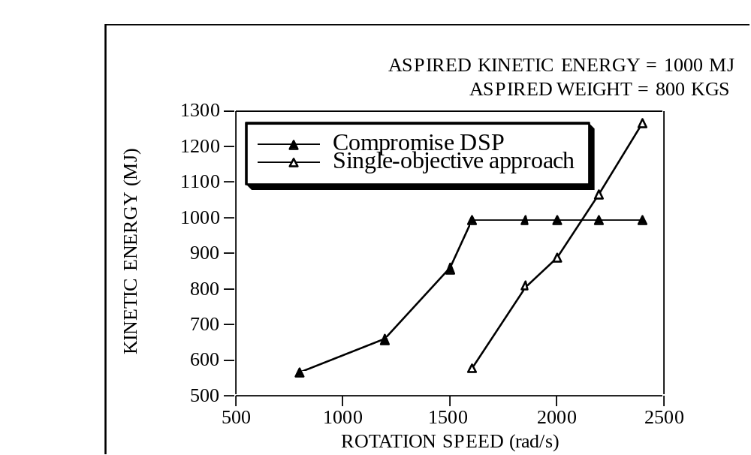
Differences in Results
By way of illustrating the "power" of a preemptive formulation, a comparison of the results obtained is made for Scenario I:
First priority: maximize the kinetic energy of the disk
Second priority: minimize the mass.
• The aspiration levels for these objectives are set at 1000 MJ and 800 kgs respectively
Note that compromise DSP solution "sticks" to 1000 MJ while trying to minimize weight.
Question: At what speed do you expect a minimum weight?

